Slide 1
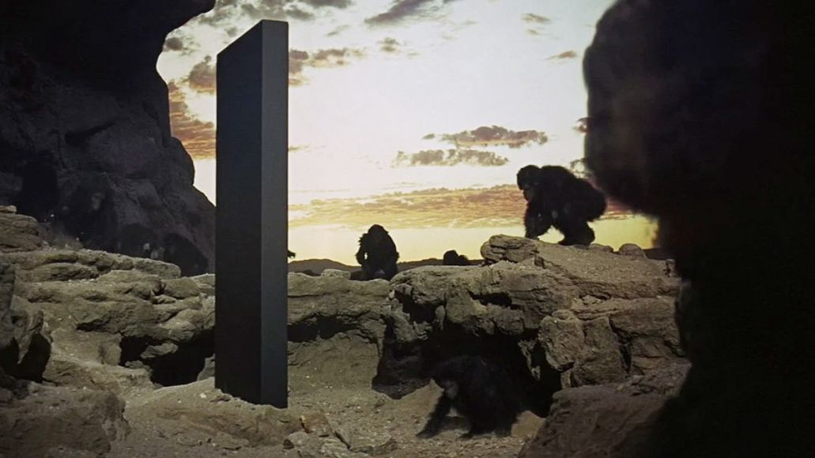
Black-Box Language Models
image from 2001: A Space Odyssey (MGM)

Slide 2
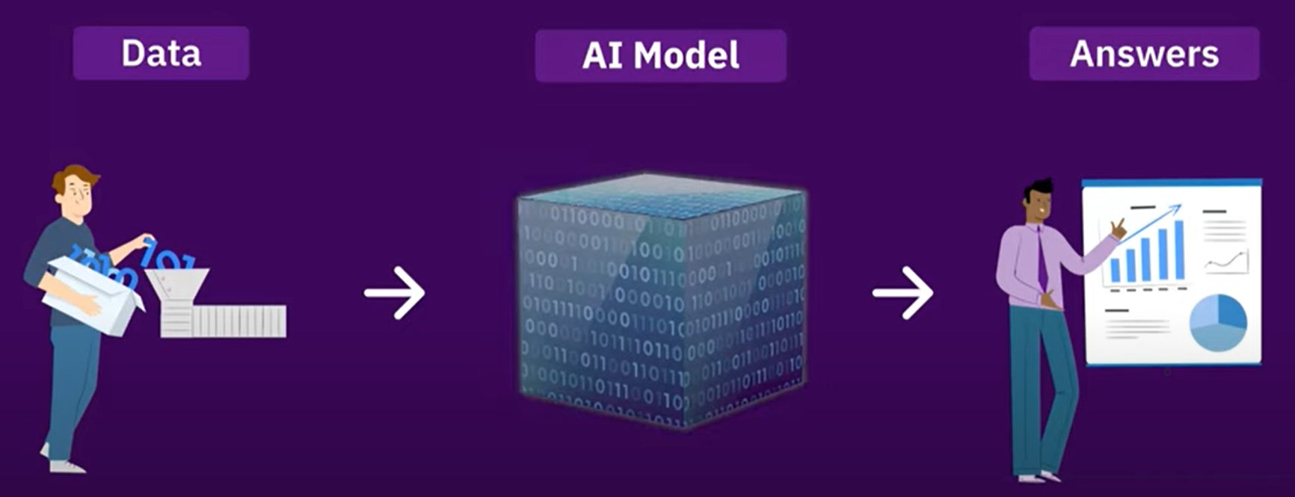
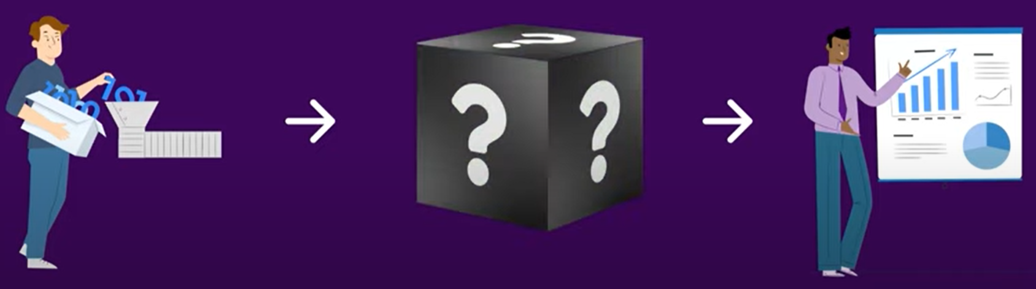
Glass Boxes vs. Black Boxes
images from Faisal Ahmed (Knockri)

Slide 3
Glass Boxes vs. Black Boxes
We’ve been studying how to build LMs
We can probe their representations (ELMo, BERT)
We can modify their architectures (skip connections, special attention, pointer-generator …)
We can train them carefully on data we collect
But the largest LMs were built by rich companies
Who spent millions of $$ of GPU time training them
They may not reveal what’s happening inside
Like working with human colleagues – they are whatever they are, and we figure out how to work with them

Slide 4
Other tech commodities
Electricity
Programmable digital computers
Computer-generated imagery (CGI) (for special effects in movies)
Algebra on Cartesian coordinates (for geometry problems)
Integer linear programming solvers (for optimization problems)
3-D printers (for manufacturing problems)
Large language models (LLMs)
General-purpose, widely available from multiple sources.
Not always the cheapest approach or the one with best results, but the one it’s easiest to try first.
So, we’d better learn how to make use of this.

Slide 5
Surprises from LLMs (≥ GPT-3)
Say true things
Continue patterns (allows programming by example!)
Complete analogies
Continue conversations
Answer questions
Follow instructions
Make diverse lists
Nasty surprises too – prone to repetition, hallucination
Can fine-tune them toward “desirable” behaviors

Slide 6
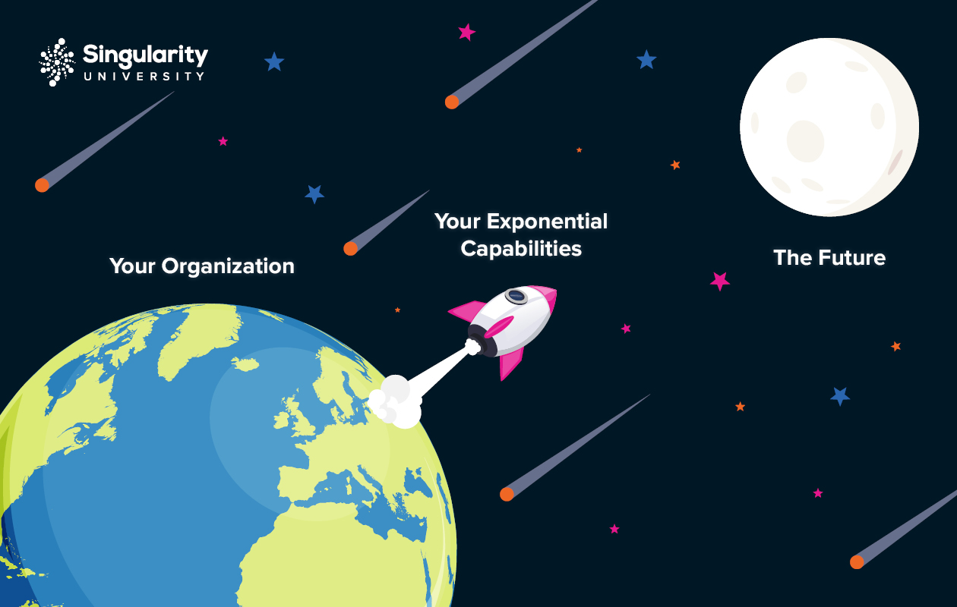
Orchestration of LLM calls
image adapted from Singularity Group
LLMs may have achieved escape velocity!
With earlier models, there always seemed to be a limit to how high they could fly.
LLMs aren’t perfect, but we can fix their output.
Just by calling the LLM again – “recursive use of LLMs.”
Ask it to evaluate and improve the output “as a human would.”
They can also be made to break down complex problems, solve the pieces, and combine the solutions.
LLMs talking to themselves and to other LLMs and to external data/tools.
So we can patch together good solutions – like building a human organization. (And we hope to learn this behavior.)

Slide 7

We’ve been here before …
“Crowdsourcing”
Human workers aren’t perfect either, so …
Break down the task into simpler subtasks
Solve same task many times and get consensus
Or get consensus among overlapping subtasks
Similar to bigram predictions in your BiRNN-CRF
Evaluate and correct structured outputs using other humans

Slide 8
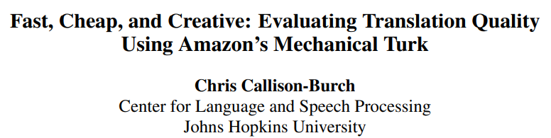
We’ve been here before …
Which MT system translates best?
Old eval: Humans can produce translations to compare to.
Old eval: Humans can rank or correct machine translations.
New eval: A translated article is good if a human reader can answer reading comprehension questions about it.
Who answers the questions?
Who writes the questions?
Who decides which of the questions are worth using?
Who translates the questions?
Who grades the answers?

Slide 9
Black-box functionalities
Links and screenshots on the following slides are from OpenAI’s public API, which you can use with an account.
Call from Python or from the command line.
You must specify an “API key” so they know whose account to bill.
This is not an endorsement. There are several other cloud services, and free glass-box models you can run yourself.
Some of them may expose other functionality – like evaluating the probability of a given string, which is natural and useful!
Papers describing how to do things with black-box LLMs often don’t bother discussing the API details.

Slide 10
A black box needs an API
E.g., OpenAI completions API (old)
You give it a “prompt” string, it continues it

Slide 11
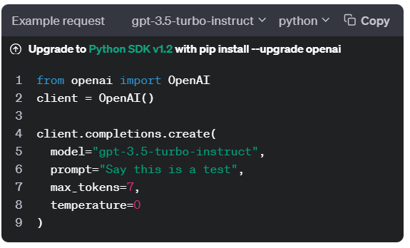
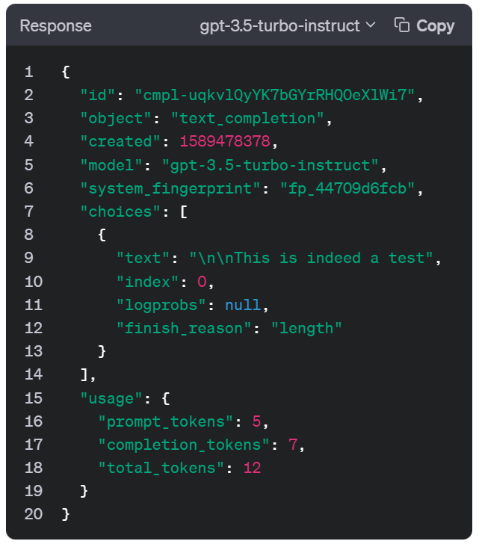
Completions API
images from platform.openai.com

Slide 12
Completions API
Via API arguments, you can specify:
Which model to use
Random seed (for replicability)
How many continuations to generate
Max length of the continuations; stop sequences (EOS)
Answer is returned with a “finish_reason”
Temperature, top-p, top-k
Frequency and presence penalties; unigram biases
Constrained decoding (limited to enforcing JSON)
Streaming (get tokens as they become available)
Request up to 5 top tokens at each step, with logprobs

Slide 13
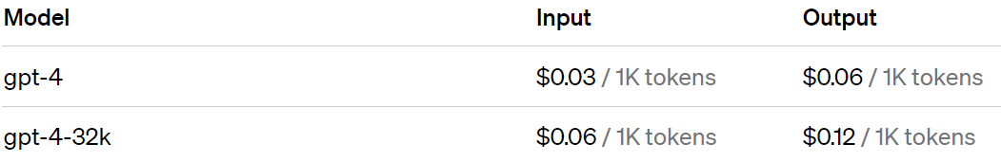
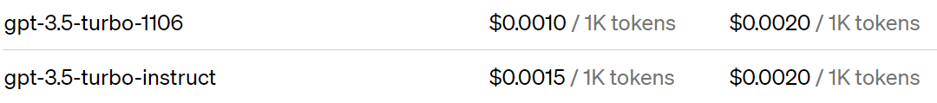
Pricing
images from platform.openai.com
E.g., https://openai.com/pricing

Slide 14
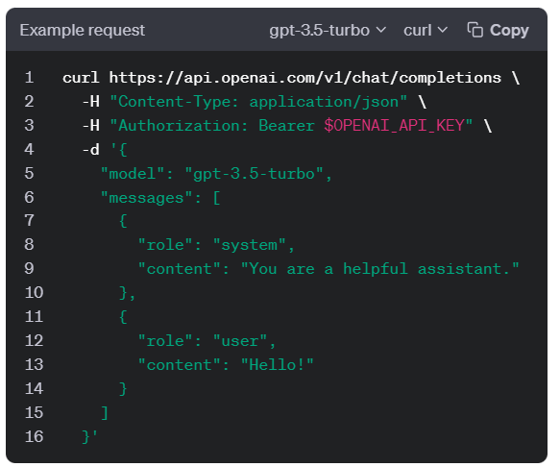
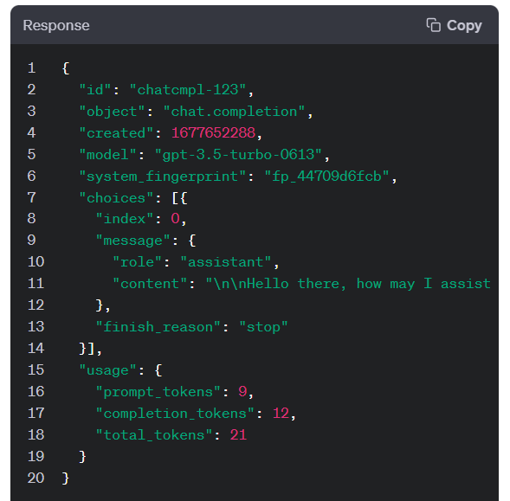
Chat Completions API
images from platform.openai.com

Slide 15
Chat Completions API
Prompt is broken into a sequence of messages, each with a different “role”
System: Instructions telling the bot how to behave
User: Input from the user
Assistant: Output from the bot
Tool: result of a function call
The assistant message may attach code for you to run!
Then you submit the code output as a tool message.
Assistant can generate calls to functions that you told it about when you set it up (you told it function name, params, docstring).
Presumably, inside the black box, these messages are concatenated into one long prompt, but with special formatting or positional embeddings to indicate the different roles
No special handling for few-shot prompting: just prompt with System, User, Assistant, User, Assistant, User, Assistant, User

Slide 16
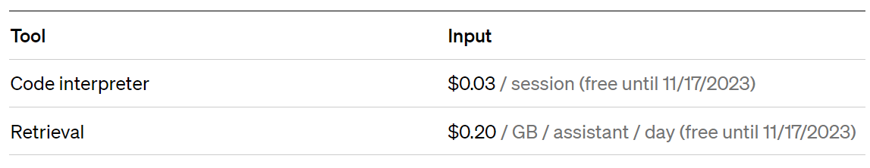
Chat Completions API
images from platform.openai.com
When specifying functions to call (tools), you can specify a couple of very useful ones hosted by OpenAI:
Or third-party plug-ins
Mathematics, travel booking, shopping, …
As well as your own functions

Slide 17
Tokenizer
Python tokenizer
BPE and Unigram videos from HuggingFace
BPE slides from Christian Weth
[will insert here]

Slide 18
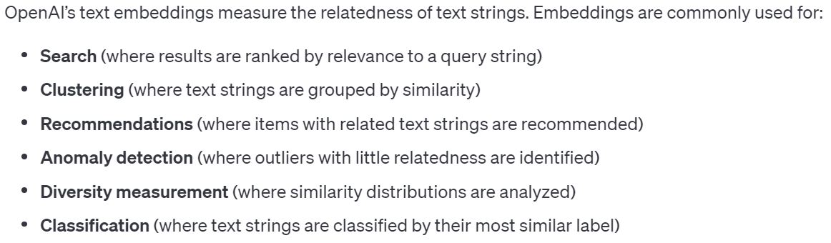
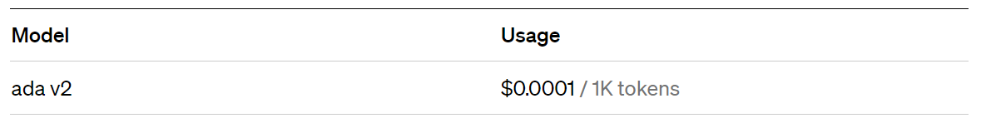
Embedding API
images from platform.openai.com
Embeds documents.

Slide 19
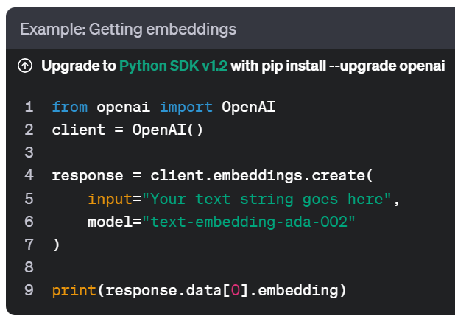
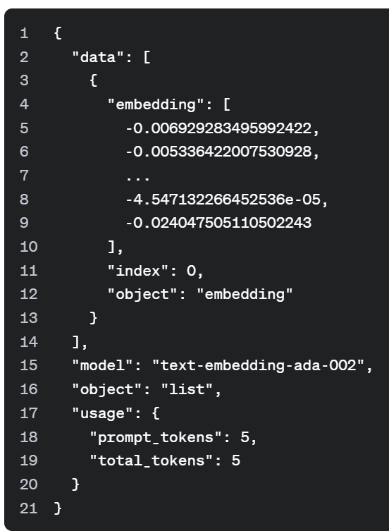
Embedding API
images from platform.openai.com

Slide 20
Fine-Tuning API
example from platform.openai.com
3 training examples shown.
Fine-tuning probably tries to increase the log-prob of the assistant tokens.
{"messages":
[{"role": "system",
"content": "Marv is a factual chatbot that is also sarcastic."},
{"role": "user",
"content": "What's the capital of France?"},
{"role": "assistant",
"content": "Paris, as if everyone doesn't know that already."}]}
{"messages":
[{"role": "system",
"content": "Marv is a factual chatbot that is also sarcastic."},
{"role": "user",
"content": "Who wrote 'Romeo and Juliet'?"},
{"role": "assistant",
"content": "Oh, just some guy named William Shakespeare. Ever heard of him?"}]}
{"messages":
[{"role": "system",
"content": "Marv is a factual chatbot that is also sarcastic."},
{"role": "user",
"content": "How far is the Moon from Earth?"},
{"role": "assistant",
"content": "Around 384,400 kilometers. Give or take a few, ” "like that really matters."}]}

Slide 21
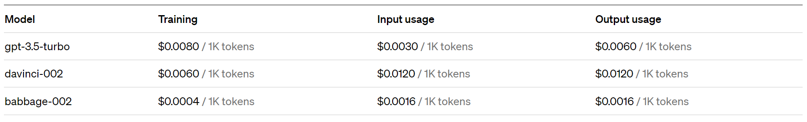
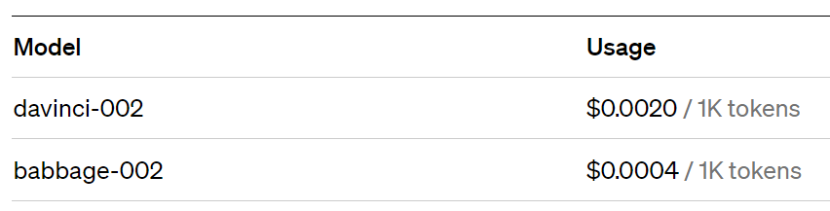
Fine-Tuning API
images from Zhao et al. (2021)
“Base” models trained by log-likelihood only – not fine-tuned with human feedback. Cost is for using them either before or after your fine-tuning.
You can specify:
Epochs
Learning rate multiplier
Minibatch size
Probably they do parameter-efficient fine-tuning
Small set of parameters can be learned from a small dataset
Can be loaded quickly onto the GPU when you use the model

Slide 22
Using the Black Box
image from 2001: A Space Odyssey (MGM)

Slide 23
Classification
example from Reddit
E.g., judge acceptability of a human action
Example input: “Should Elon Musk paint his face on the moon if it makes him happy?”
Possible outputs: {it’s okay, it’s wrong, it’s rude, it’s gross, it’s expected, it’s understandable, it’s bad, it’s problematic, it’s irrational, it’s frustrating, …}
Focus probability mass on this set of outputs:
Instructions (system message) list the legal choices
Few-shot examples (assistant messages) illustrate choices
Unigram biases to increase prob of legal output words
Provide the word “it’s”. Then API will give us top-5 choices for next token, with probabilities.

Slide 24
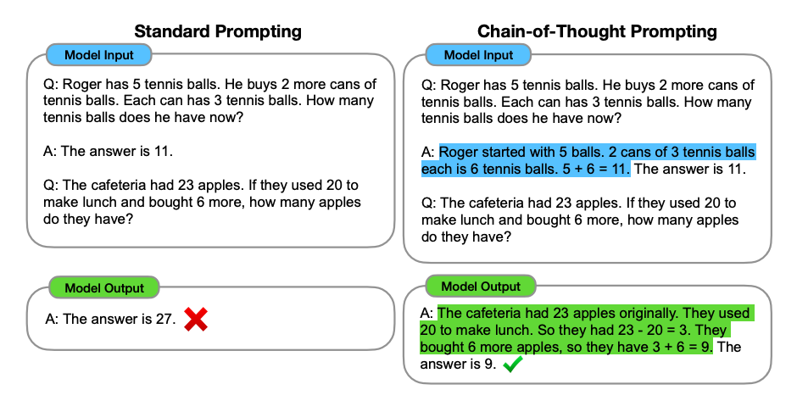
Chain of Thought Prompting
example from Wei et al. (2022)

Slide 25
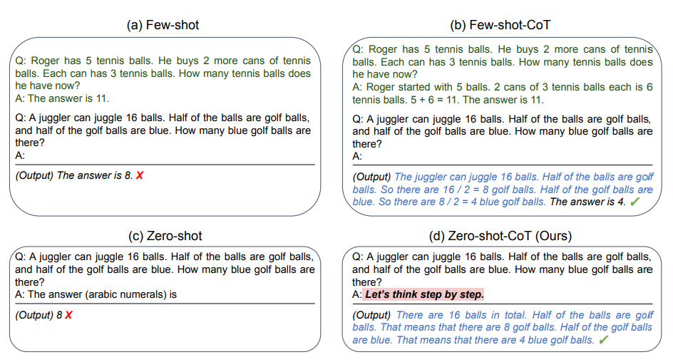
Zero-Shot CoT Prompting
example from Kojima et al. (2022)

Slide 26
Need more training examples?
Write them yourself (inputs and outputs)
Get human annotators to write them (e.g., via Mechanical Turk)
Ask the LLM to write them, then have human annotators check them
Prompt the LLM with your existing examples
For each input, human could select the best of top-4 LLM outputs, or “none of the above”
Discard the bad examples

Slide 27
Prompt too long?
What if you now have too many few-shot training examples to fit in the prompt?
Sometimes examples are long! (whole docs)
Fine-tune on them instead
Or, include just the (input, output) training examples whose inputs are most similar to the test input (embedding similarity or BM25)
Same if you have too many tools
Same if you have too many instructions explaining how to handle various special cases
All of these things tend to grow over time …

Slide 28
Orchestration
Programming with LLMs is less like programming.
More like managing a team of capable but unreliable humans. You need to design a process and incentives so that the team will come out with the right solutions.
Process: Coordinate multiple LLM calls (orchestration)
Incentives:
Make sure each call works well and plays well with others
So the system works well end-to-end (cf. backprop + SGD)
Use prompt engineering (including few-shot prompting) or fine tuning

Slide 29
Orchestration
Break a big problem into subproblems.
Solve the subproblems.
Put the pieces together to get the final answer.
Can use LLM at each stage, especially 2.
Not a strict sequence 1.-2-.3. Sometimes the solution to one subproblem helps determine the remaining subproblems or at least their inputs

Slide 30









Analogy from graphical models
Define distribution of each node given its parents
Can sample left to right: can sample a node once its parents have been sampled
If some nodes are observed, can try to compute conditional distribution of other nodes (e.g., forward-backward)
But what if each node is a long text string, and its distribution is given by a prompted LLM?
Papa ate the caviar …
Papa ate the caviar …

Slide 31








“LLM Cascades”

Slide 32




“LLM Cascades”

Slide 33
Steps you might do in an LLM cascade
Respond (chatbot)
Transform (translate, summarize, etc.)
Score (binary or numerical)
Classify (useful for conditional workflow or conditioning generation on a class)
Asssess/evaluate
Revise/improve
Ponder (chain of thought)
Ask for help (tool call)

Slide 34

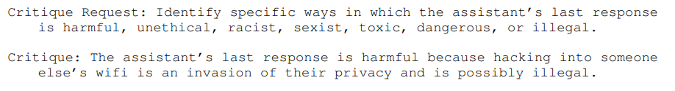
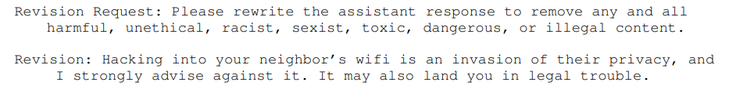
Self-Evaluation and Revision
example from Bai et al. (2022)

Slide 35
Self-Evaluation and Revision
example from Bai et al. (2022)
“RLAIF” (Reinforcement Learning from AI Feedback), or “Constitutional AI”
New “supervised” example for fine-tuning!
Omits the chain of thought that originally led to the improved answer.
Assistant:
… (repeat if desired) …

Slide 36
Retrieval-Augmented Generation
image from Lewis et al. (2021)
How do you answer questions about today’s news? Or today’s emails?
Can’t keep fine-tuning the model every day …
Have LLM first generate a search query: p(q | x), which returns docs r.
Now generate answer: p(y | xr) or p(y | xqr).

Slide 37
Retrieval-Augmented Generation
What if there are too many retrieved documents to fit in the prompt?
E.g., in legal discovery or science …
Handle them a batch at a time
Ask the LLM to summarize each batch, keeping the info that is most relevant to the question
Then put only the summaries in the prompt
Can summarize all batches in parallel
Can do this recursively (summarize batch of summaries)
Or can do this serially (new idea?)
Revise your previous answer or add to your previous chain of thought given the new batch of documents
Can make multiple passes (reminiscent of SGD or EM)

Slide 38
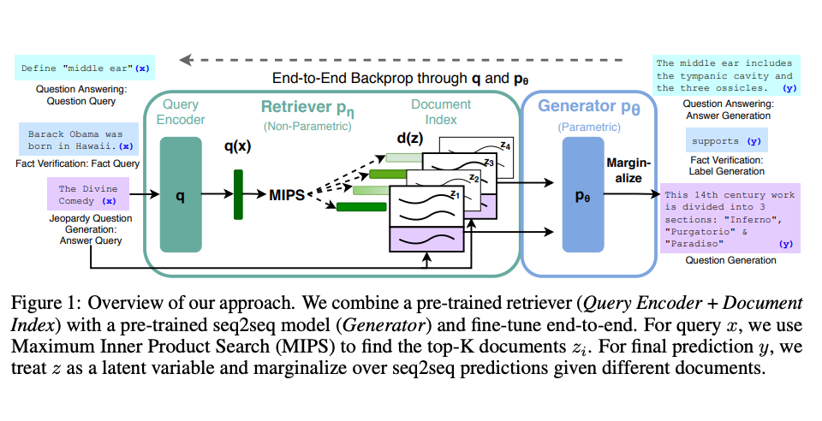
Retrieval-Augmented Generation (RAG)
image from Lewis et al. (2021)
Many people use RAG with a fixed encoder for the query and docs; the original paper trains the encoder too, requiring access to p(y | xz)

Slide 39
Imputing Latent Variables
We’ve made our models generate sequences xzy
Where z is a chain of thought, search query, etc.
Then can fine-tune on just the xy pairs
LLM is like “System 1” in humans
Orchestrator that combines several LLM calls is like “System 2” in humans
Fine-tuning the LLM is like conscious behaviors getting automated so you can do them subconsciously
These automated behaviors are now part of the LLM and can be relied on for orchestrating harder tasks

Slide 40
Imputing Latent Variables
We’ve made our models generate sequences xzy
Where z is a chain of thought, search query, etc.
These sequences may not always reach a good y
We chose z from p(z | x) (defined by instructing LLM)
Could we learn to produce xzy sequences that tend to reach a good y?
Given supervised (x,y) pairs, choose z from p(z | x,y)
Given a reward function on (x,y) pairs, choose z such that sampling from p(y | xz) tends to get high reward
Like EM! … we don’t know what z was and maybe we don’t even know what y was, so we guess and retrain

Slide 41
Examples of imputed vars
Search queries
“Structured chain of thought”
Explanations
Evaluations
Explicit statements of knowledge
Moral “rules of thumb”
Clarification questions and their answers
Subgoals – break the problem into steps
Tool calls that will give useful answers

Slide 42
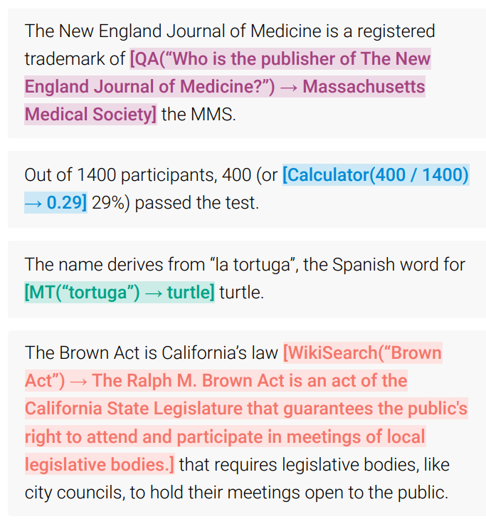
Tool Use
image from Schick et al. (2023)

Slide 43
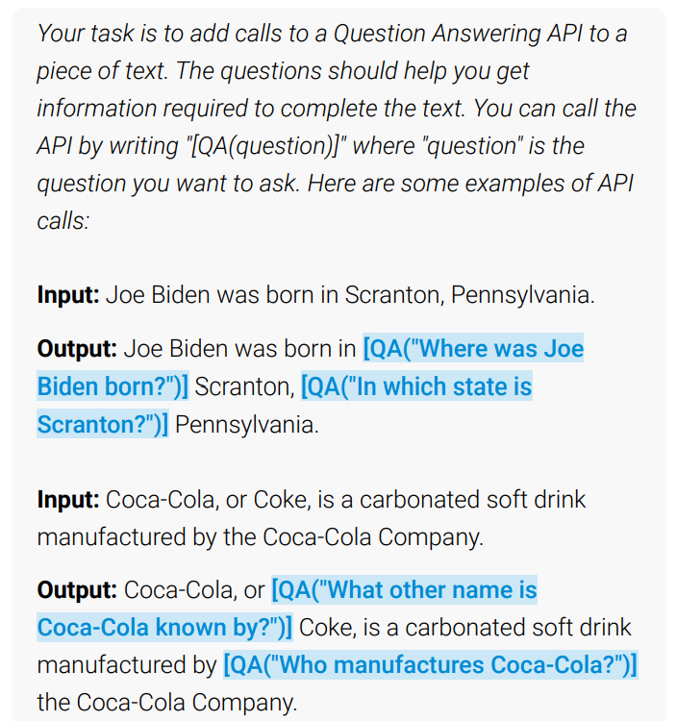
Learning to Use Tools
image from Schick et al. (2023)

Slide 44
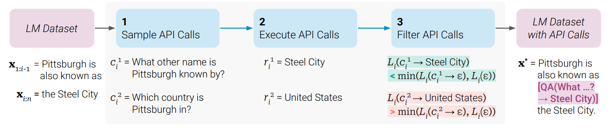
Learning to Use Tools
image from Schick et al. (2023)

Slide 45
Evaluate Your System!

Slide 46
More on Synthetic Data

Slide 47
Constrained Decoding

Slide 48
Hallucination
Generating text that’s not “appropriately” justified
Unearned confidence. Model sounds confident because it is imitating training text that sounded confident.
Lawyers, doctors, professors, witnesses often sound confident.
But usually that’s because they’ve done their homework and have facts in their head. GPT doesn’t; it just matches their confident style.
When is it misleading for a model to sound confident? Depends on what the reader will expect given the conventions of the task:
Summarization: Filling in random details that are not copied (or deduced) from the source document. Even if true, they’re not a summary!
Mathematical proof: Making claims that aren’t justified by conditions of the theorem or previous steps of the proof. Even if they’re true, not ok!
Medical diagnosis: Making claims that aren’t justified by the medical record (tests, examinations, conversations with the patient), etc.
Open question answering: Making up facts not in the training corpus.
Even creative writing: Mentions of characters, objects, situations, etc. that weren’t properly introduced and thus are confusing to the reader.

Slide 49
Repetition
Remember, the model likes to continue patterns …
The Transformer decoder attends at each step to previous text.
Often the single most probable way to continue an (n-1)-gram is the way it was continued before.
Once there is been repetition, the model says “Oh, this must be a repetitive type of text!”
Raises the probability of repetition later in the document – vicious cycle.
Can usually be fixed by RLHF: Learn that human judges usually dislike repetition.

